Slide 1

“E-Commerce Website ”
Presented By
NAME
Autonomy Roll No
Arpita Nath
12622001035
Internship Project for B.TECH Course 2022-2026 Batch
Guided By
Mr. Sourav Goswami
On
CLOUD-BASED FULL STACK DEVELOPMENT WITH AI & ML
INTEGRATION USING MERN
Ardent Computech Pvt. Ltd.

Slide 2

PROBLEM STATEMENT
The Commerce platform is a full-featured e-commerce solution designed to offer a
seamless digital shopping experience for consumers and streamlined management tools
for administrators.
The primary objective of Commerce is to enable users to browse products, manage a
cart, place orders, and complete secure payments—while offering sellers a user-friendly
interface .

Slide 3
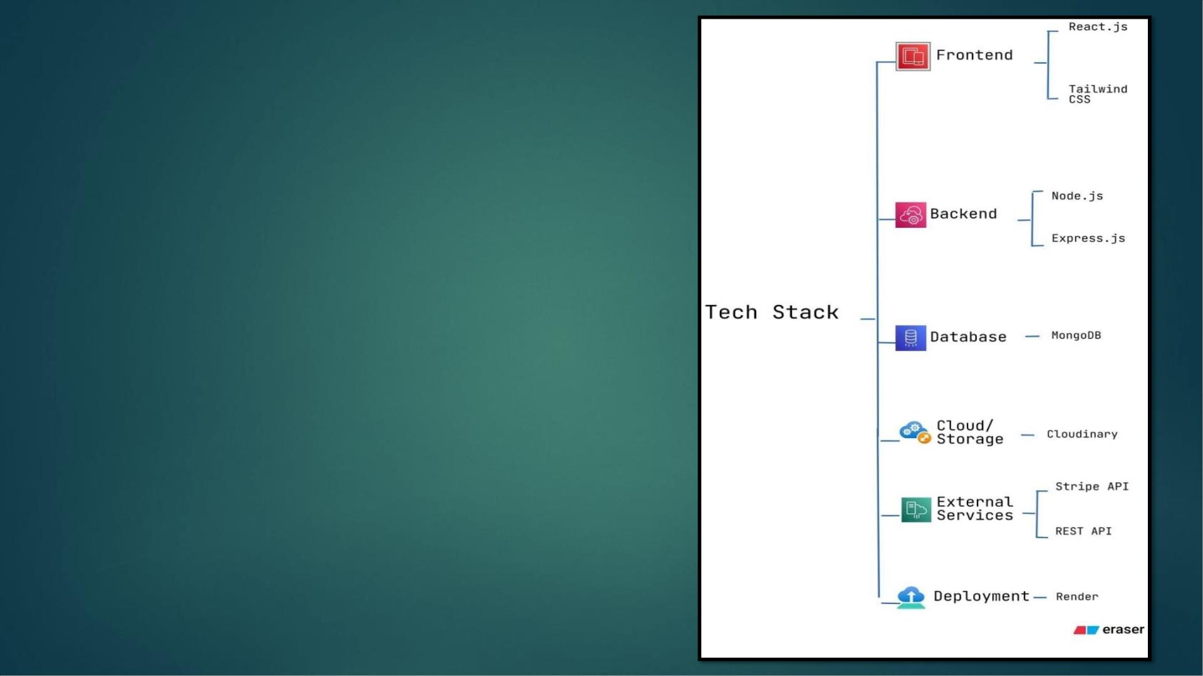
HARDWARE AND
SOFTWARE REQUIREMENTS
Scalability & Security:
• Cloud-based for global access and high concurrency
• Secure payments
• Role-based access control
• Data encryption and backup for safety
Future Scopes:
• Recommendation System
• AR View
• Offline Mode

Slide 4
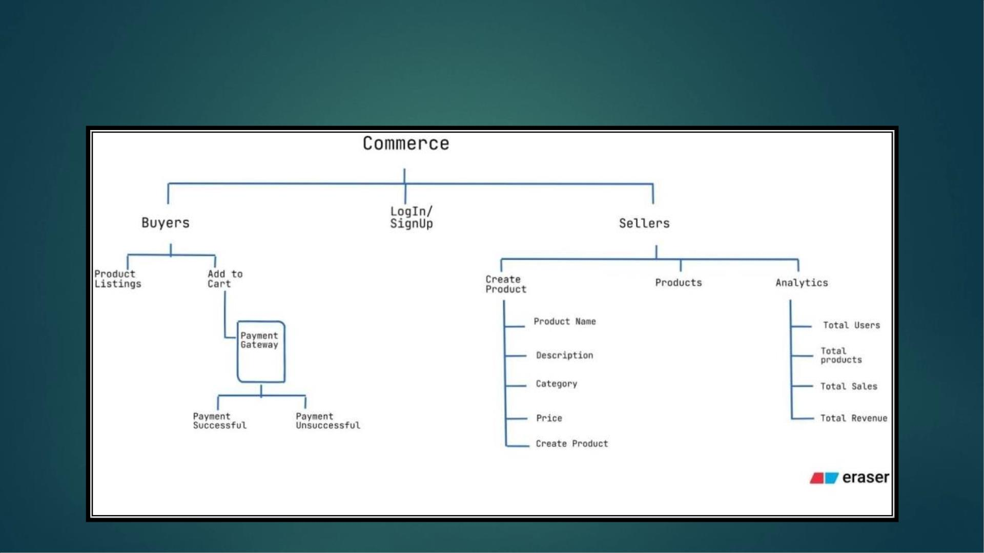
PRODUCT OVERVIEW DIAGRAM

Slide 5
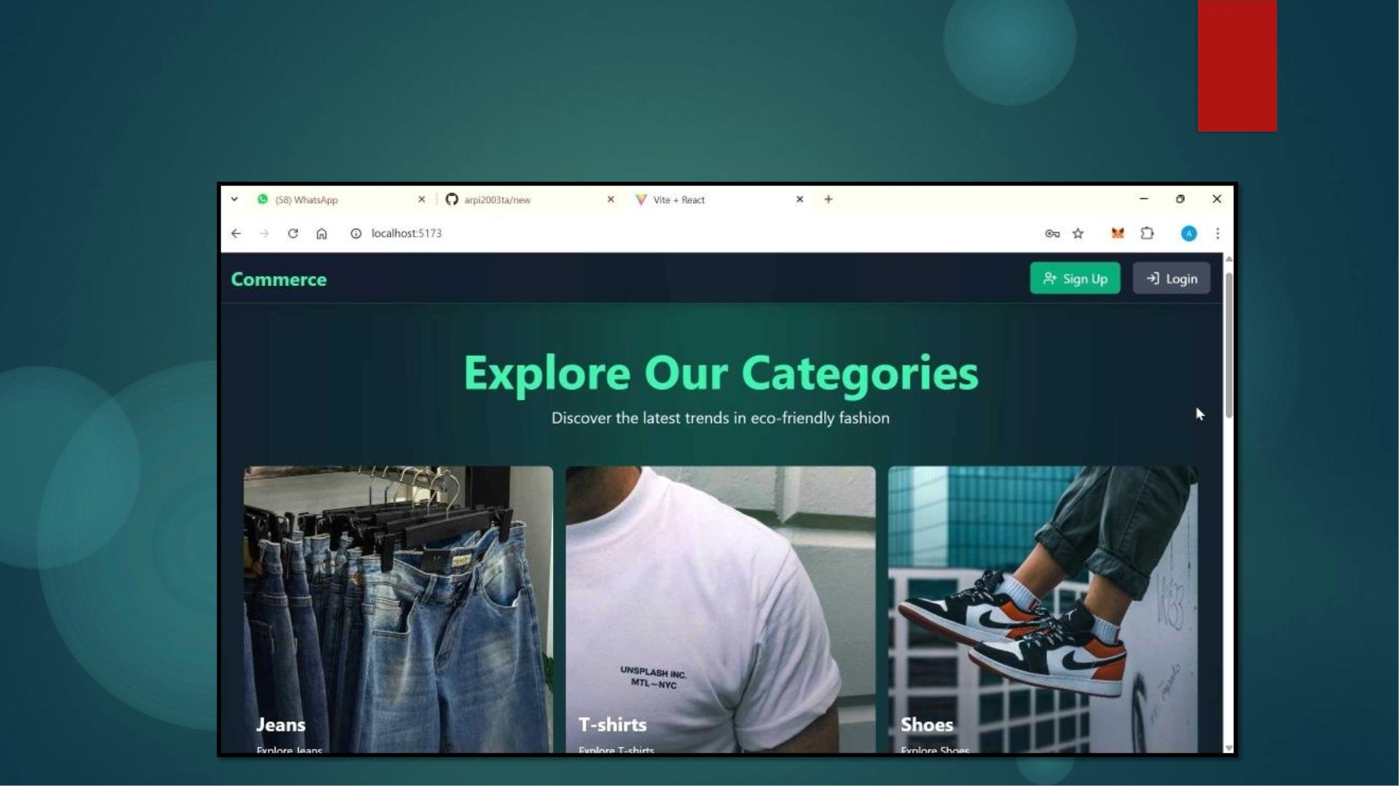
DEMO VIDEO OF THE PROJECT

Slide 6

REFERENCES
Git Repo -
Deployed link -
Youtube link -

Slide 7
THANK
YOU

